Slide 1

Approved Football Officiating Mechanics
Goal Line, Pass, Reverse,
Run, & Victory Mechanics 6/6/20

Slide 2
How to Use this Presentation
5 Man appears first, followed by 4 Man.
To play the presentation, select “Slide Show” from the top of the screen, then click “From Beginning”.
Words highlighted in red indicate changes this year.
To get out of a slide to see the notes & motion, hit the “ESC” key. To resume, click “From Current Slide” from the top menu.
For notes about each slide’s motion, print the “Notes Page.”

Slide 3
5 Man Mechanics

Slide 4
Goal Line Mechanics (GLM) POE:
GLM: Defined as snap touching +10YL to GL.
Wings IP: Important to be 2 YDS OOB at the Snap.
Wings: Must Pivot at GL when Runner goes into EZ.
There MUST be an official on the GL when the FB crosses the GL.
“Let your mind digest what your eyes have seen” before signaling TD.
Do NOT mirror TD. Signal TD ONLY if you see it.

Slide 5
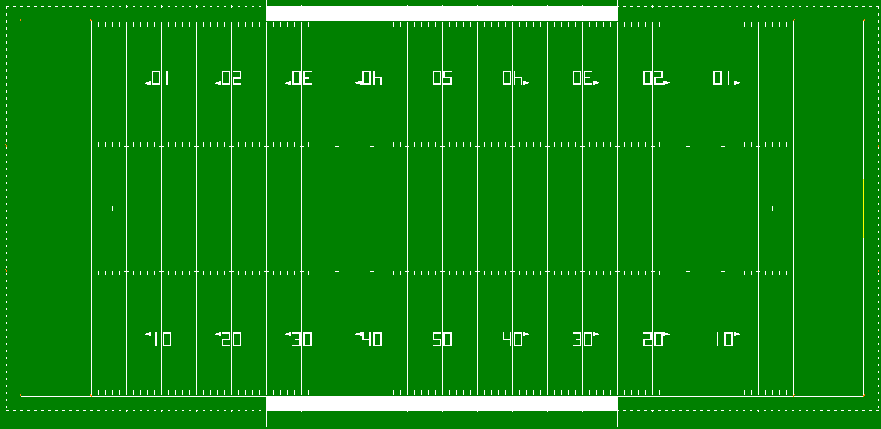





GLM (R&R1): +10YL to +5YL

Slide 6
GLM (R&R2): +5YL to GL

Slide 7
GLM (R&R2): Wings Pinch – Field of Play

Slide 8

GLM(R&R2): Wings Pinch on GL

Slide 9
GLM (R&R2): Runner at Pylon
Notes:
<Click> HL aggressively slides down GL when runner moves to the opposite SL.

Slide 10
GLM (R&R2): EL & SL Corner
Eye Contact

Slide 11
GLM: Wing Unsure; U Knows
I’m sure it’s a TD

Slide 12
Reverse Mechanics (RM) POE
RM: Defined as snap is inside the -10YL.
R&R1 is now from the GL to the -5YL.
R & Wings: MUST communicate by hand signals on every down – who has the GL.
R: IP is always on EL. If it is R&R1 or 2 the R will NEVER call a safety. The Wings will call it!
MUST have a Wing on GL when FB crosses GL.

Slide 13
RM (R&R1): -5YL to GL; Wings to GL

Slide 14

RM (R&R1): -5YL to GL; Safety

Slide 15
RM (R&R1): -5YL to GL; Read QB & RB

Slide 16
RM (R&R2): -10YL to -5YL; Wings 1 Step Back

Slide 17
Near GL: -10YL to -15YL; R’s IP 10 YDS Wide

Slide 18
Pass Mechanics (PM) POE
PM: Defined as the spot of the snap between the -10YL & +10YL.
U: Move to NZ Only when Passer threatens it.
U/HL/LJ/BJ: Move to a position a MINIMUM of 5 YDS from the Catch.
R: YELL “Ball’s Away” Slowly. Hit on QB After R yells “Ball’s Away” is a Roughing the Passer foul.
R/HL/LJ/BJ: When space permits STOP 5 YDS from pile of players to see dead ball action.

Slide 19
Pass Mechanics (PM) POE
Wings: Important to read the play & know R&R1, R&R2, & R&R3.
BJ IP: Stay at 20 YDS until FB is snapped between the + 15YL & +10YL. Then move 5 YDS into EZ.
KNOW Keys: Check QB’s eyes – Where is he looking.
Pass Play: Watch A tackle/guard – stand up.
SL/EL Catch or No Catch: Watch Feet FIRST, then Catch.

Slide 20
Pass Mechanics (PM) POE
Moment of Judgment: Use “Stop-N-Watch”.
Crew: Keep head level & swivel once ball is dead.
R: ONLY he throws a flag for Intentional Grounding. Others will communicate to him.
BJ: Stay between hashes until the ball is dead. Is the “windshield wiper” – SL to SL.
Wing: Must “open the door” to protect yourself when receiver moves between the numbers & SL.

Slide 21
PM: IP – BJ 5YDS Deep in EZ
Notes:
<click> R<click> 8 YDS wide from QB & 15 YDS behind LOS (always on wide side)
<click> U <click> 7 YDS off LOS & between normal TE position (doesn’t have to be opposite the R)
<click> Wings <click> 10 YDS from widest receiver, but never inside the tops of the numbers (if WR is less than 10 YDS from the SL, line up 2 YDS OOB)
<click> BJ <click> 20 YDS from LOS, always between goal posts

Slide 22
PM: BJ IP – Prevent Defense

Slide 23
PM: Wings & BJ - Coverage

Slide 24
PM: Wings & BJ - Coverage

Slide 25
PM: Wings & BJ - Coverage

Slide 26
PM: Wings & BJ - Coverage

Slide 27
PM (R&R1): Pass In Flat – “Stay Home”
Turn to see Catch/No Catch

Slide 28

PM (R&R2): Short Pass – 5YD Drop
Stay 5 yds. from catch

Slide 29
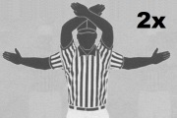
PM (R&R3): Long Pass – Turn & Burn
Notes:
To be used on each team’s first KO, and if K’s kicker threatens GL.
<click> BJ, U, HL & LJ put their hands up to indicate they’re ready
<click> R blows ready-for-play

Slide 30
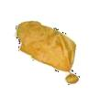
PM: Ineligible Illegally Downfield

Slide 31
PM (R&R2): Cross Field Mechanics

Slide 32
PM: R – Preventive Officiating
Ball’s Away!
Stay with QB
Don’t be a Head Wagger!

Slide 33
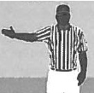
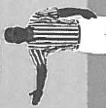
PM: R & Wings – Backward Pass
Back!
Back!
Back!

Slide 34
PM: R & U – Passer Beyond LOS

Slide 35
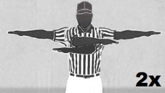
PM: U – Trapped Pass

Slide 36
PM: Intentional Grounding
There was no receiver in the area

Slide 37
Run Mechanics (RUM) POE
Wing: When runner goes OOB, turn & look OOB. Watch players return to the field.
Crew: Important to keep head level & swivel once ball is dead.
Keys: Watch the A tackle & guard – fire out = run play.
R/HL/LJ/BJ: When space permits STOP 5 YDS from the pile of players to better see dead ball action.
BJ: Stay between the hashes during the run, then hustle to the SL as needed once the ball is dead.
Point of Attack (POA): Where the action is & your concentration.

Slide 38
RUM: Run to SL: “Open Door”

Slide 39
Victory Mechanics (VCM) POE
VCM Definition: Winning Team HC informs officials we are “going to take a knee”. Opponent is out of team time-outs or tells Wing that we will not use them. Winning Team is ahead by 9 or more points.
Crew: If Winning Team HC is winning by 8 points or less, inform teams to Defend Themselves.
Communication: Inform losing team HC.
R: Inform QB that he MUST take a knee.
Crew: All pinch in close. Inform both teams.

Slide 40
Victory Mechanics (VCM)

Slide 41
4 Man Mechanics

Slide 42
Goal Line Mechanics (GLM) POE
GLM: Defined as snap touching +10YL to GL.
Wings IP: Important to be 2 YDS OOB at the Snap.
U: Your IP is on the EL for better coverage.
Wings: Must Pivot at GL when Runner goes into EZ.
There MUST be an official on the GL when the FB crosses the GL.
Do NOT mirror TD. Signal TD ONLY if you see it.

Slide 43
GLM (R&R1): +10YL to +5YL

Slide 44
GLM (R&R2): +5YL to GL

Slide 45

GLM (R&R2): Wings Pinch – Field of Play

Slide 46
GLM (R&R2): Wings Pinch on GL

Slide 47
GLM (R&R2): Runner at Pylon

Slide 48

GLM (R&R2): EL & SL Corner
Eye Contact

Slide 49
Reverse Mechanics (RM) POE
RM: Defined as snap is inside the -10YL.
R&R1 is now from the GL to the -5YL.
R & Wings: MUST communicate by hand signals on every down – who has the GL.
R: IP is always on EL. If it is R&R1 or 2 the R will NEVER call a safety. The Wings will call it!
MUST have a Wing on GL when FB crosses GL.

Slide 50
RM (R&R1): -5YL to GL; Wings to GL

Slide 51
RM (R&R1): -5YL to GL; Safety

Slide 52
RM (R&R1): -5YL to GL; Read QB & RB

Slide 53
RM (R&R2): -10YL to -5YL; Wings 1 Step Back

Slide 54
Near GL: -10YL to -15YL; R’s IP 10 YDS Wide

Slide 55
Pass Mechanics (PM) POE
PM: Defined as the spot of the snap between the - 10YL & +10YL.
R: YELL Ball’s Away Slowly. Hit on QB After R yells it is a Roughing the Passer Foul.
U/HL/LJ/BJ: Move to a position a MINIMUM of 5 YDS from the Catch.
R/HL/LJ: When space permits STOP 5 YDS from pile of players to better see dead ball action.
Wings: MUST read play & know R&R1/R&R2/R&R3

Slide 56
Pass Mechanics (PM) POE
U: Move to NZ Only when Passer threatens it.
SL/EL Catch?: Watch Feet FIRST, then Catch.
R: ONLY he throws a flag for Intentional Grounding. Others will communicate to him.
KNOW keys: Check QB’s eyes – Where looking?
Moment of Judgment: Use “Stop-N-Watch.
Keys: Watch Team A tackle & guard stand up = pass play.

Slide 57
PM: IP
Notes:
<click> R <click> 8 YDS wide from QB & 15 YDS behind LOS (always on wide side)
<click> U <click> 7 YDS off LOS & between normal TE position (doesn’t have to be opposite the R)
<click> Wings <click> 10 YDS from widest receiver, but never inside the tops of the numbers (if WR is less than 10 YDS from the SL, line up 2 YDS OOB)

Slide 58
PM – Wings - Coverage

Slide 59
PM (R&R1): Pass In Flat – “Stay Home”
Turn to see Catch/No Catch

Slide 60
PM (R&R2): Short Pass – 5YD Drop
Stay 5 yds. from catch

Slide 61
PM (R&R3): Long Pass – Turn & Burn
Notes:
To be used on each team’s first KO, and if K’s kicker threatens GL.
<click> BJ, U, HL & LJ put their hands up to indicate they’re ready
<click> R blows ready-for-play

Slide 62
PM: Ineligible Illegally Downfield

Slide 63
PM (R&R2): Cross Field Mechanics

Slide 64
PM: R – Preventive Officiating
Ball’s Away!
Stay with QB
Don’t be a Head Wagger!

Slide 65
PM: R/HL/LJ – Backward Pass
Back!
Back!
Back!

Slide 66
PM: R & U – Passer Beyond LOS

Slide 67
PM: U – Trapped Pass

Slide 68
PM: Intentional Grounding
There was no receiver in the area

Slide 69
Run Mechanics (RUM) POE
Wing: When runner goes OOB, turn & look OOB. Watch players return to the field.
Crew: Important to keep head level & swivel once ball is dead.
R/HL/LJ: When space permits STOP 5 YDS from the pile of players to better see dead ball action.
Keys: Watch the A tackle & guard – fire out = run play.
Wing: When runner is near SL “open door” to protect yourself.
Point of Attack (POA): Where the action is & your concentration.

Slide 70
RUM: Run to SL: “Open Door”

Slide 71
Victory Mechanics (VCM) POE
VCM Definition: Winning Team HC informs officials we are “going to take a knee”. Opponent is out of team time-outs or tells Wing that we will not use them. Winning Team is ahead by 9 or more points.
Crew: If Winning Team HC is winning by 8 points or less, inform teams to Defend Themselves.
Communication: Inform losing team HC.
R: Inform QB that he MUST take a knee.
Crew: All pinch in close. Inform both teams.

Slide 72
Victory Mechanics (VCM)

